Slide 1
Form validation and reactive forms
Hardeep Kaur Dhalla

Slide 2
Objectives
Form validation
Reactive forms

Slide 3
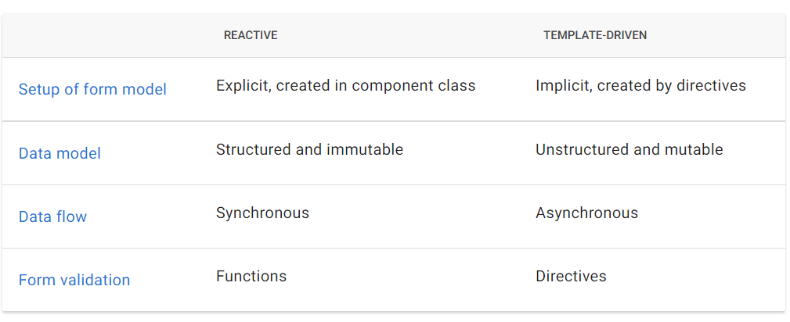
Key differences – Reactive Vs. template-driven

Slide 4
Form validation
Angular provides a set of built-in validators as well as the ability to create custom validators.
Reactive forms define custom validators as functions that receive a control to validate.
Template-driven forms are tied to template directives and must provide custom validator directives that wrap validation functions.

Slide 5
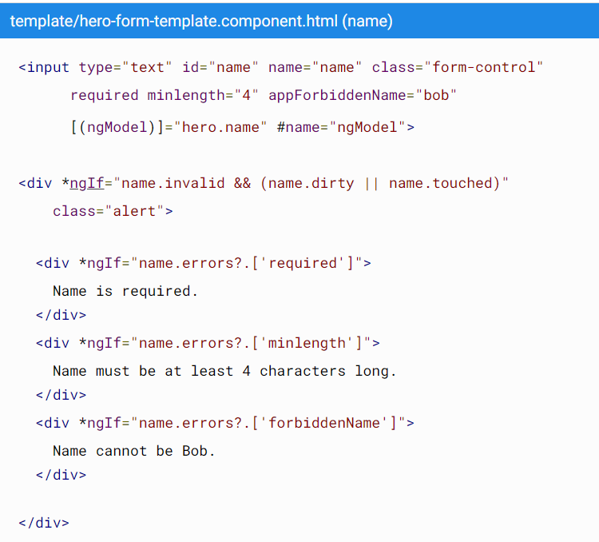

Slide 6
Control status CSS classes
Use these classes to style form control elements according to the state of the form. The following classes are currently supported.
.ng-valid
.ng-invalid
.ng-pending
.ng-pristine
.ng-dirty
.ng-untouched
.ng-touched
.ng-submitted (enclosing form element only)

Slide 7
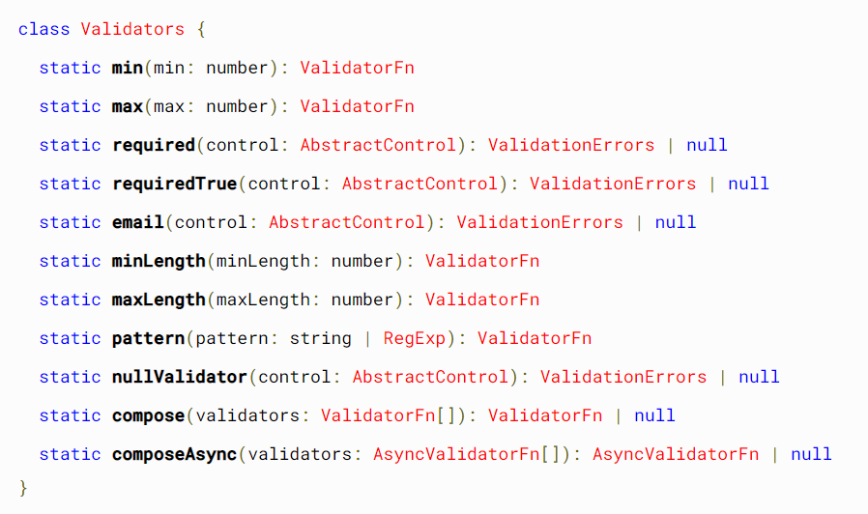
Validators class
A validator is a function that processes a FormControl or collection of controls and returns an error map or null. A null map means that validation has passed.
https://angular.io/api/forms/Validators
https://angular.io/api?type=directive

Slide 8
Reactive forms
a model-driven approach to handling form inputs whose values change over time.
Help in maintaining the integrity of the model between changes.
Easy to test and scale.
Reactive forms provide
synchronous access to the data model,
immutability with observable operators,
and change tracking through observable streams.
To use reactive form controls, import ReactiveFormsModule from the @angular/forms package and add it to your NgModule's imports array.

Slide 9
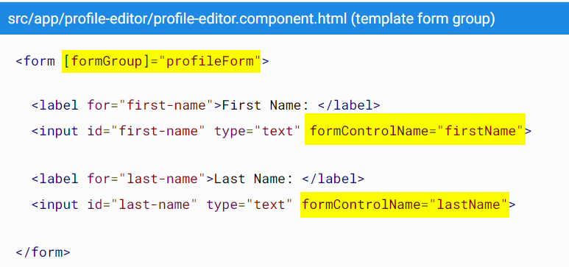
Reactive forms
import { FormGroup, FormControl } from '@angular/forms’;
FormControl for individual control
FormGroup for creating group of controls

Slide 10
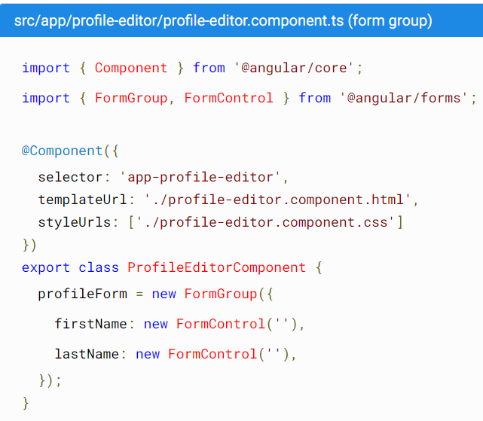
Reactive forms

